Slide 1
EE663
Image Processing
Histogram Equalization
Dr. Samir H. Abdul-Jauwad
Electrical Engineering Department
King Fahd University of Petroleum & Minerals
Notes:
Good afternoon and thank you everyone for coming.
My talk today will describe the research I performed at the IRIS at USC, the object of this work being to build a computational framework that addresses the problem of motion analysis and interpretation.

Slide 2
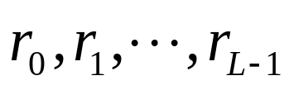
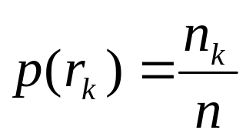
Image Enhancement: Histogram Based Methods
What is the histogram of a digital image?
• The histogram of a digital image with gray values
is the discrete function
n_{k}: Number of pixels with gray value r_{k}
n: total Number of pixels in the image
• The function p(r_{k}) represents the fraction of the total number of pixels with gray value r_{k}.

Slide 3
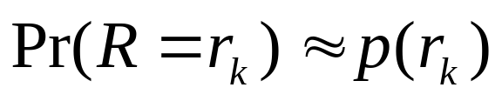
• Histogram provides a global description of the appearance of
the image.
• If we consider the gray values in the image as realizations of a
random variable R, with some probability density, histogram
provides an approximation to this probability density. In other
words,

Slide 4
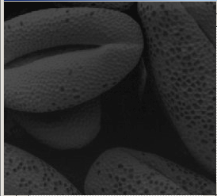
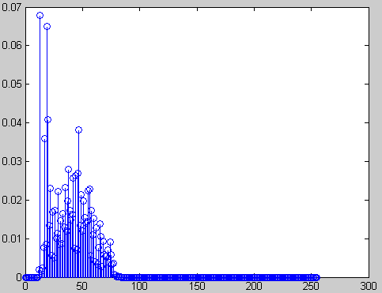
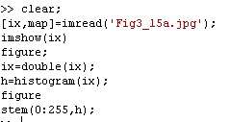
Some Typical Histograms
• The shape of a histogram provides useful information for
contrast enhancement.
Dark image

Slide 5
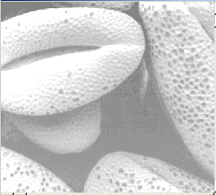
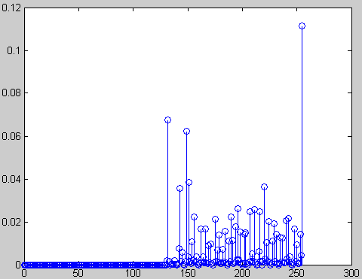
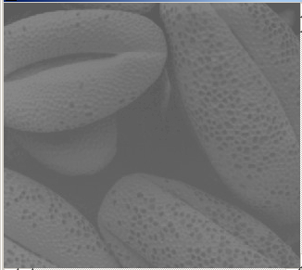
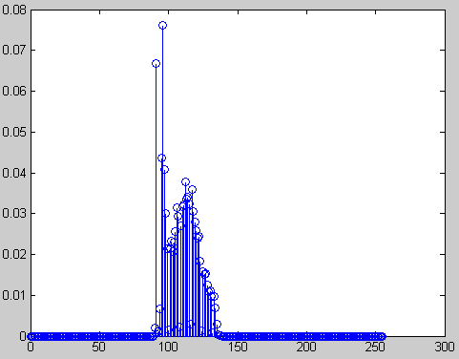
Bright image
Low contrast image

Slide 6
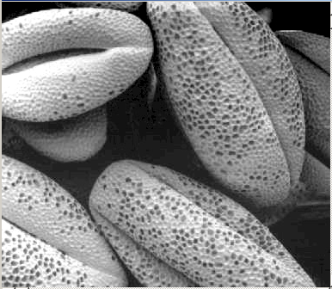
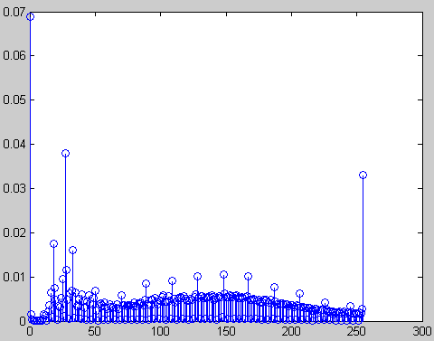
High contrast image

Slide 7
Histogram Equalization
• What is the histogram equalization?
• Τhe histogram equalization is an approach to enhance a given image. The approach is to design a transformation T(.) such that the gray values in the output is uniformly distributed in [0, 1].
• Let us assume for the moment that the input image to be
enhanced has continuous gray values, with r = 0 representing
black and r = 1 representing white.
• We need to design a gray value transformation s = T(r), based
on the histogram of the input image, which will enhance the
image.

Slide 8
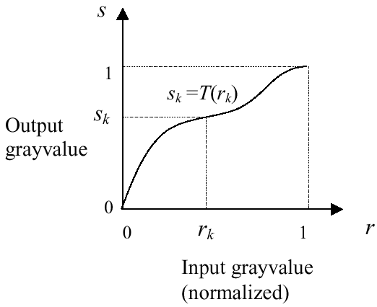
• As before, we assume that:
(1) T(r) is a monotonically increasing function for 0 ≤ r ≤ 1 (preserves order from black to white).
(2) T(r) maps [0,1] into [0,1] (preserves the range of allowed
Gray values).

Slide 9
• Let us denote the inverse transformation by r = T ⁻¹(s) . We
assume that the inverse transformation also satisfies the above
two conditions.
• We consider the gray values in the input image and output
image as random variables in the interval [0, 1].
• Let p_{in}(r) and p_{out}(s) denote the probability density of the
Gray values in the input and output images.

Slide 10
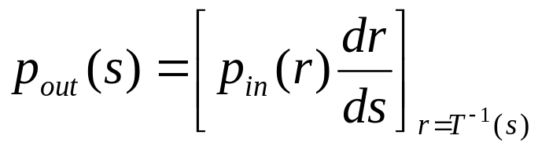
• If p_{in}(r) and T(r) are known, and r = T ⁻¹(s) satisfies condition 1, we can write (result from probability theory):
• One way to enhance the image is to design a transformation
T(.) such that the gray values in the output is uniformly
distributed in [0, 1], i.e. p_{out} (s) = 1, 0 ≤ s ≤1
• In terms of histograms, the output image will have all
gray values in “equal proportion” .
• This technique is called histogram equalization.

Slide 11
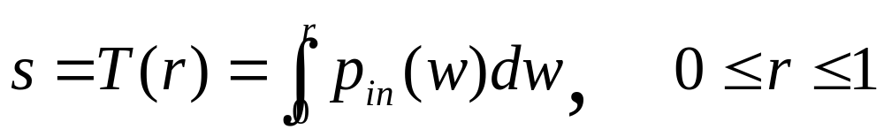
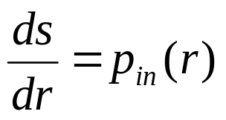
Next we derive the gray values in the output is uniformly distributed in [0, 1].
•Consider the transformation
• Note that this is the cumulative distribution function (CDF) of p_{in} (r) and satisfies the previous two conditions.
• From the previous equation and using the fundamental
theorem of calculus,

Slide 12
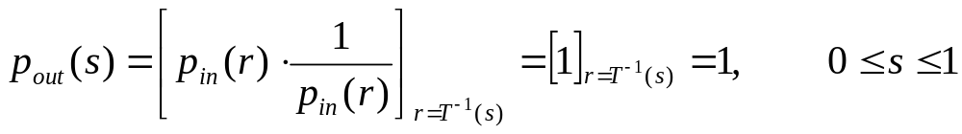
• Therefore, the output histogram is given by
• The output probability density function is uniform, regardless of the input.
• Thus, using a transformation function equal to the CDF of input gray values r, we can obtain an image with uniform gray values.
• This usually results in an enhanced image, with an increase in the dynamic range of pixel values.

Slide 13
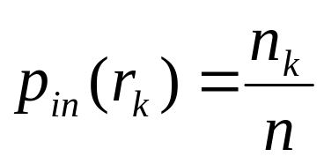


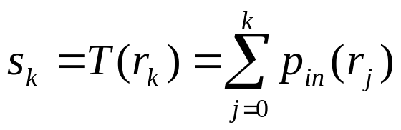
How to implement histogram equalization?
Step 1:For images with discrete gray values, compute:
L: Total number of gray levels
n_{k}: Number of pixels with gray value r_{k}
n: Total number of pixels in the image
Step 2: Based on CDF, compute the discrete version of the previous transformation :

Slide 14
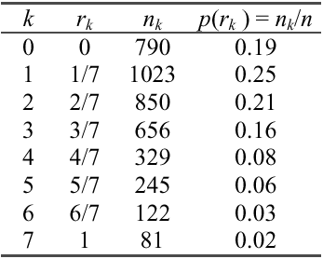
Example:
• Consider an 8-level 64 x 64 image with gray values (0, 1, …,
7). The normalized gray values are (0, 1/7, 2/7, …, 1). The
normalized histogram is given below:
NB: The gray values in output are also (0, 1/7, 2/7, …, 1).

Slide 15
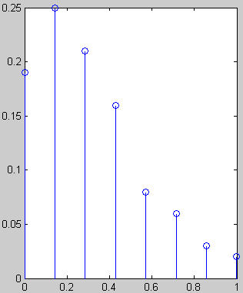
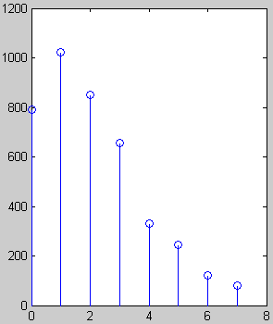


# pixels
Fraction of # pixels
Gray value
Normalized gray value

Slide 16
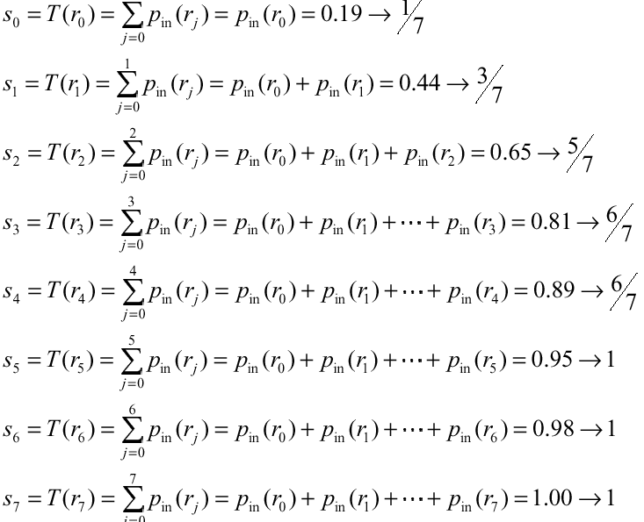
• Applying the transformation,
we have

Slide 17
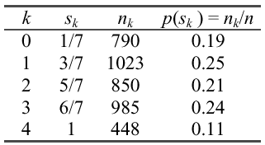
• Notice that there are only five distinct gray levels --- (1/7, 3/7,
5/7, 6/7, 1) in the output image. We will relabel them as (s₀,
s₁, …, s₄ ).
• With this transformation, the output image will have
histogram

Slide 18
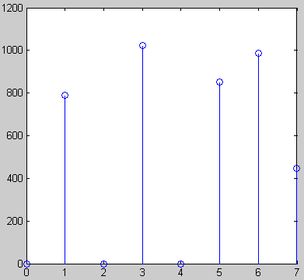

Histogram of output image
# pixels
Gray values
• Note that the histogram of output image is only approximately, and not exactly, uniform. This should not be surprising, since there is no result that claims uniformity in the discrete case.

Slide 19
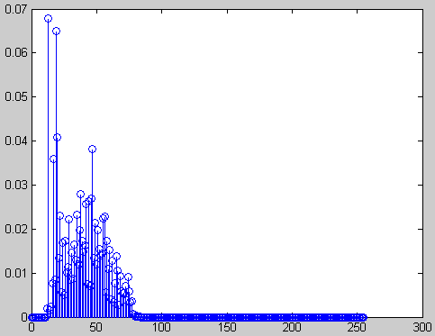
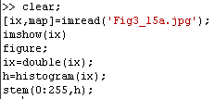
Example
Original image and its histogram

Slide 20
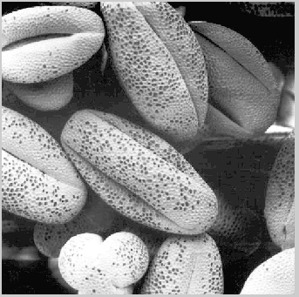
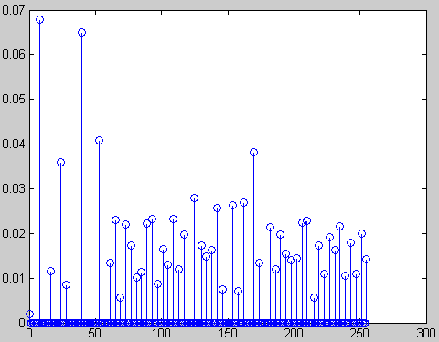
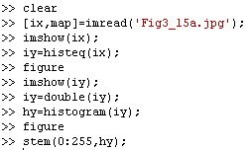
Histogram equalized image and its histogram

Slide 21
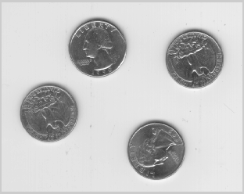
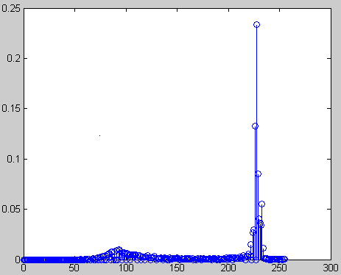
• Comments:
Histogram equalization may not always produce desirable
results, particularly if the given histogram is very narrow. It
can produce false edges and regions. It can also increase
image “graininess” and “patchiness.”

Slide 22
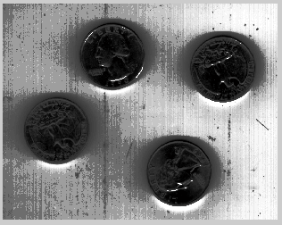
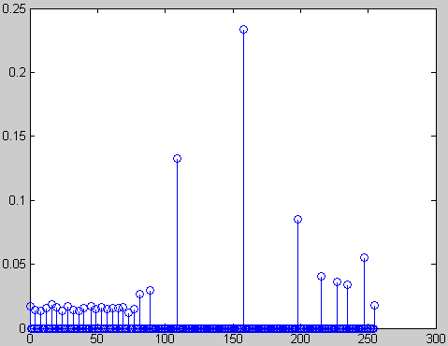
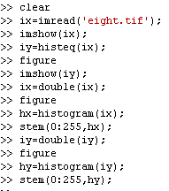

Slide 23
Histogram Specification
(Histogram Matching)
• Histogram equalization yields an image whose pixels are (in
theory) uniformly distributed among all gray levels.
• Sometimes, this may not be desirable. Instead, we may want a
transformation that yields an output image with a pre-specified
histogram. This technique is called histogram specification.

Slide 24
• Given Information
(1) Input image from which we can compute its histogram .
(2) Desired histogram.
• Goal
Derive a point operation, H(r), that maps the input image into an output image that has the user-specified histogram.
• Again, we will assume, for the moment, continuous-gray values.

Slide 25
Approach of derivation
z=H(r)
= G⁻¹(v=s=T(r))
Input image
Uniform image
Output image
s=T(r)
v=G(z)

Slide 26
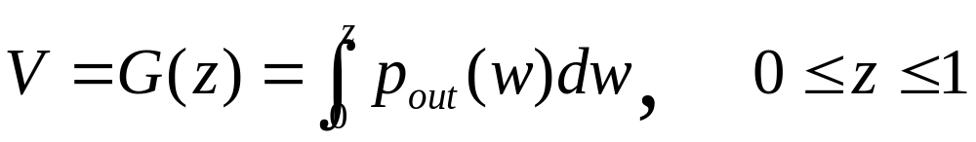
• Suppose, the input image has probability density in p(r) . We
want to find a transformation z = H (r) , such that the probability density of the new image obtained by this transformation is p_{out}(z) , which is not necessarily uniform.
• First apply the transformation
(*)
This gives an image with a uniform probability density.
• If the desired output image were available, then the following
transformation would generate an image with uniform density:
(**)

Slide 27
• From the gray values ν we can obtain the gray values z by
using the inverse transformation, z = G⁻¹(v)
• If instead of using the gray values ν obtained from (**), we
use the gray values s obtained from (*) above (both are
uniformly distributed ! ), then the point transformation
Z=H(r)= G⁻¹[ v=s =T(r)]
will generate an image with the specified density out p(z) ,
from an input image with density in p(r) !

Slide 28
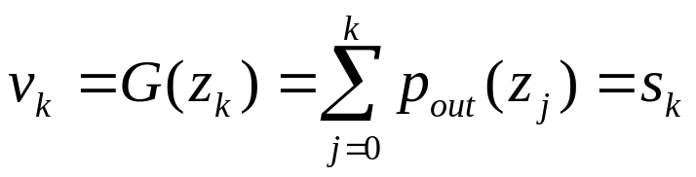
• For discrete gray levels, we have
• If the transformation z_{k} → G(z_{k}) is one-to-one, the inverse
transformation s_{k} → G⁻¹ (s_{k}) , can be easily determined, since
we are dealing with a small set of discrete gray values.
• In practice, this is not usually the case (i.e., ) z_{k} → G(z_{k}) is not one-to-one) and we assign gray values to match the given histogram, as closely as possible.

Slide 29
Algorithm for histogram specification:
(1) Equalize input image to get an image with uniform gray values, using the discrete equation:
(2) Based on desired histogram to get an image with uniform gray values, using the discrete equation:
(3)
z
=
G
−
1
(
v=s
)
→
z
=
G
−
1
[
T
(
r
)]

Slide 30
Example:
• Consider an 8-level 64 x 64 previous image.
# pixels
Gray value

Slide 31
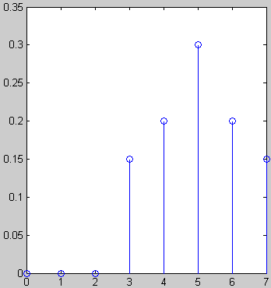
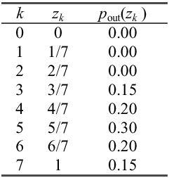
• It is desired to transform this image into a new image, using a transformation Z=H(r)= G⁻¹[T(r)], with histogram as specified below:
# pixels
Gray values

Slide 32
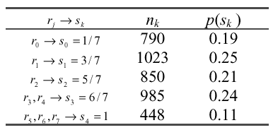
• The transformation T(r) was obtained earlier (reproduced
below):
• Now we compute the transformation G as before.

Slide 33
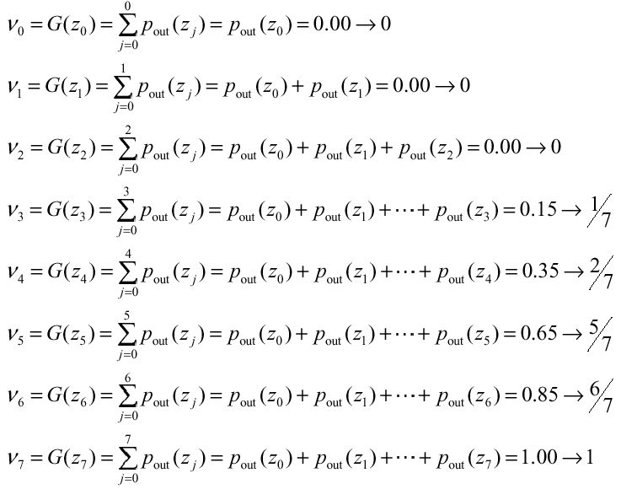

Slide 34
• Computer z=G⁻¹ (s), Notice that G is not invertible.
G⁻¹(0) = ?
G⁻¹(1/7) = 3/7
G⁻¹(2/7) = 4/7
G⁻¹(3/7) = ?
G⁻¹(4/7) = ?
G⁻¹(5/7) = 5/7
G⁻¹(6/7) = 6/7
G⁻¹(1) = 1

Slide 35
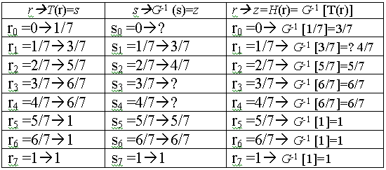
• Combining the two transformation T and G⁻¹ , compute z=H(r)= G⁻¹[v=s=T(r)]

Slide 36
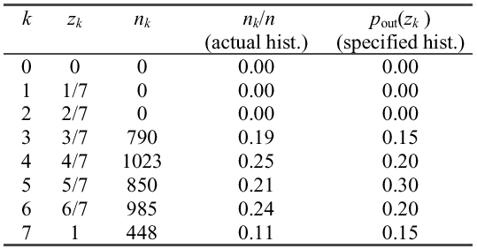
• Applying the transformation H to the original image yields an image with histogram as below:
• Again, the actual histogram of the output image does not exactly but only approximately matches with the specified histogram. This is because we are dealing with discrete histograms.

Slide 37
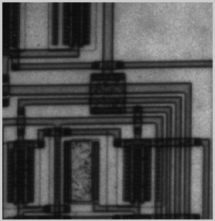
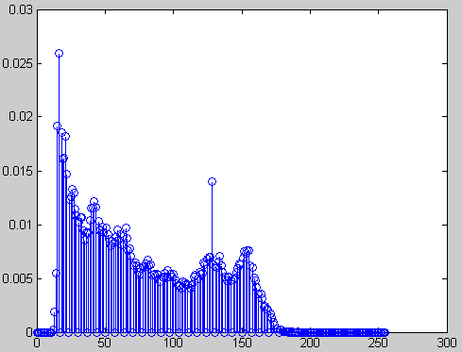
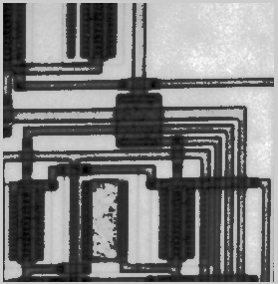
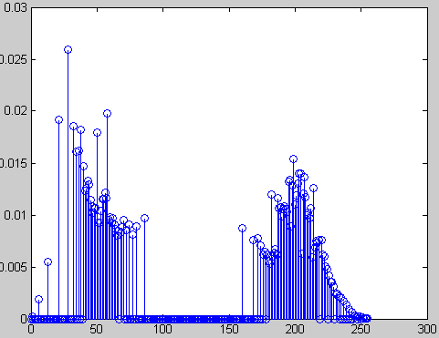
Original image and its histogram
Histogram specified image and its histogram

Slide 38
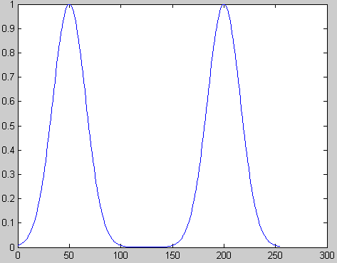
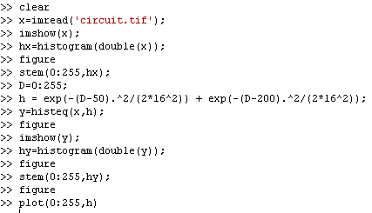
Desired histogram

